Slide 1
Divide and Conquer
Divide and Conquer –
Design Principles and Strategy,
Analyzing Divide and Conquer Algorithms,
Sorting Problem –
Merge Sort Algorithm,
Quick Sort Algorithm.
Binary Search Algorithm

Slide 2
Divide and Conquer
Design Principles and Strategy
The divide-and-conquer paradigm is often used to find an optimal solution of a problem.
Its basic idea is to divide a given problem into two or more similar, but simpler, subproblems, to solve them in turn, and to combine their solutions to solve the given problem.

Slide 3
Divide & Conquer
Given a function to compute on n inputs, the divide-and-conquer strategy consists of:
splitting the inputs into k distinct subsets, 1<k≤n, yielding k subproblems.
solving these subproblems
combining the sub solutions into solution of the whole.
if the subproblems are relatively large, then Divide and Conquer is applied again.
if the subproblems are small, then are solved without splitting.

Slide 4
Three Steps of The Divide and Conquer Approach
The most well known algorithm design strategy:
Divide the problem into two or more smaller subproblems.
Conquer the subproblems by solving them recursively.
Combine the solutions to the subproblems into the solutions for the original problem.

Slide 5
A Typical Divide and Conquer Case
a problem of size n
subproblem 1
of size n/2
subproblem 2
of size n/2
a solution to
subproblem 1
a solution to
subproblem 2
a solution to
the original problem

Slide 6
Divide & Conquer(Merge Sort)

Slide 7

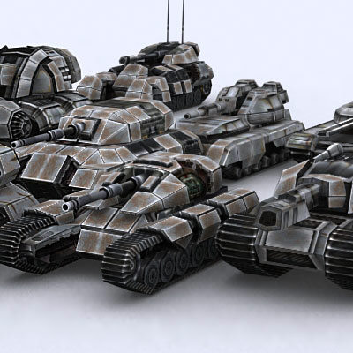
Merge Sort
Divide and Conquer cuts the problem in half each time, but uses the result of both halves:
cut the problem in half until the problem is trivial
solve for both halves
combine the solutions
Merge Sort, a sorting algorithm exploiting Divide and Conquer Technique

Slide 8
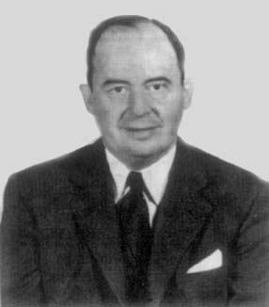
Merge Sort
Developed merge sort for EDVAC in 1945
John von Neumann
(1903-1957)

Slide 9
Merge two sorted lists into a single sorted list
The key to Merge Sort is merging two sorted lists into one, such that if you have two lists X (x₁≤x₂≤…≤x_{m}) and Y(y₁≤y₂≤…≤y_{n}) the resulting list is Z(z₁≤z₂≤…≤z_{m+n})
Example: L₁ = { 3 8 9 }
L₂ = { 1 5 7 }
merge(L₁, L₂) = { 1 3 5 7 8 9 }
What is complexity of the below mentioned algorithm?

Slide 10
Merge two sorted lists into a single sorted list
original:
3 | 10 | 23 | 54 | 1 | 5 | 25 | 75
X:
3 | 10 | 23 | 54
Y:
1 | 5 | 25 | 75
Result:

Slide 11
Merge two sorted lists into a single sorted list
X:
3 | 10 | 23 | 54
Y:
 | 5 | 25 | 75
Result:
1

Slide 12
Merge two sorted lists into a single sorted list
X:
 | 10 | 23 | 54
Y:
 | 5 | 25 | 75
Result:
1 | 3

Slide 13
Merge two sorted lists into a single sorted list
X:
 | 10 | 23 | 54
Y:
 |  | 25 | 75
Result:
1 | 3 | 5

Slide 14
Merge two sorted lists into a single sorted list
X:
 |  | 23 | 54
Y:
 |  | 25 | 75
Result:
1 | 3 | 5 | 10

Slide 15
Merge two sorted lists into a single sorted list
X:
 |  |  | 54
Y:
 |  | 25 | 75
Result:
1 | 3 | 5 | 10 | 23

Slide 16
Merge two sorted lists into a single sorted list
X:
 |  |  | 54
Y:
 |  |  | 75
Result:
1 | 3 | 5 | 10 | 23 | 25

Slide 17
Merge two sorted lists into a single sorted list
X:
Y:
 |  |  | 75
Result:
1 | 3 | 5 | 10 | 23 | 25 | 54

Slide 18
Merge two sorted lists into a single sorted list
X:
Y:
Result:
1 | 3 | 5 | 10 | 23 | 25 | 54 | 75

Slide 19
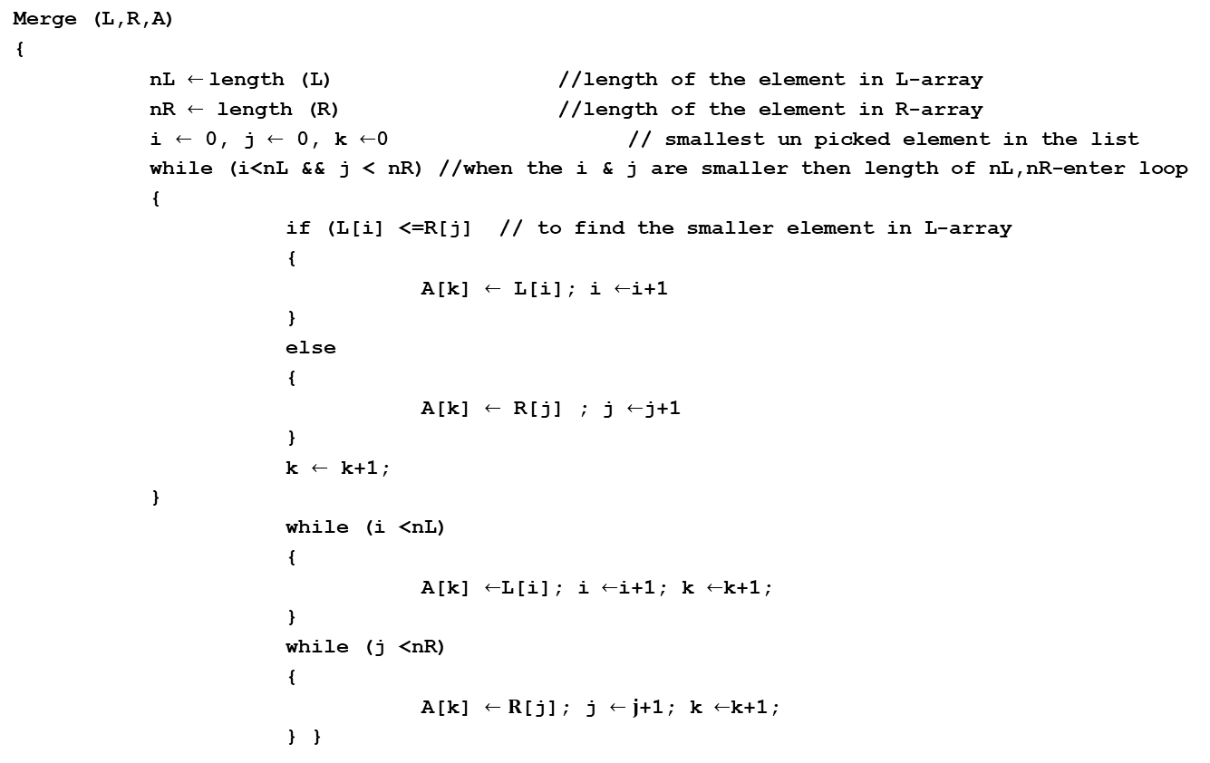
Pseudocode of the Merge two sorted lists into a single sorted list

Slide 20
Merge Sort
A divide-and-conquer algorithm:
Divide the unsorted array into 2 halves until the sub-arrays only contain one element
Merge the sub-problem solutions together:
Compare the sub-array’s first elements
Remove the smallest element and put it into the result array
Continue the process until all elements have been put into the result array
37
23
6
89
15
12
2
19

Slide 21
Merge Sort Algorithm
Mergesort(Pass an array)
if array size > 1
Divide array in half
Call Mergesort on first half.
Call Mergesort on second half.
Merge two halves.
Merge(Pass two arrays)
Compare leading element in each array
Select lower and place in new array.
(If one input array is empty then place
remainder of other array in output array)

Slide 22
Merge Sort Algorithm
MergeSort(A, left, right) {
if (left < right) {
mid = floor((left + right) / 2);
MergeSort(A, left, mid);
MergeSort(A, mid+1, right);
Merge(A, left, mid, right);
}
}
// Merge() takes two sorted subarrays of A and
// merges them into a single sorted subarray of A
// (how long should this take?)

Slide 23
Analysis of Merge Sort
Statement Effort
So T(n) = Θ(1) when n = 1, and 2T(n/2) + Θ(n) when n > 1
So what (more succinctly) is T(n)?
MergeSort(A, left, right) { T(n)
if (left < right) { Θ(1)
mid = floor((left + right) / 2); Θ(1)
MergeSort(A, left, mid); T(n/2)
MergeSort(A, mid+1, right); T(n/2)
Merge(A, left, mid, right); Θ(n)
}
}

Slide 24
98
23
45
14
6
67
33
42
98
23
45
14
6
67
33
42
98
23
45
14
6
67
33
42
98
23
45
14
6
67
33
42
23
98
14
45
6
67
33
42
14
23
45
98
6
33
42
67

Slide 25
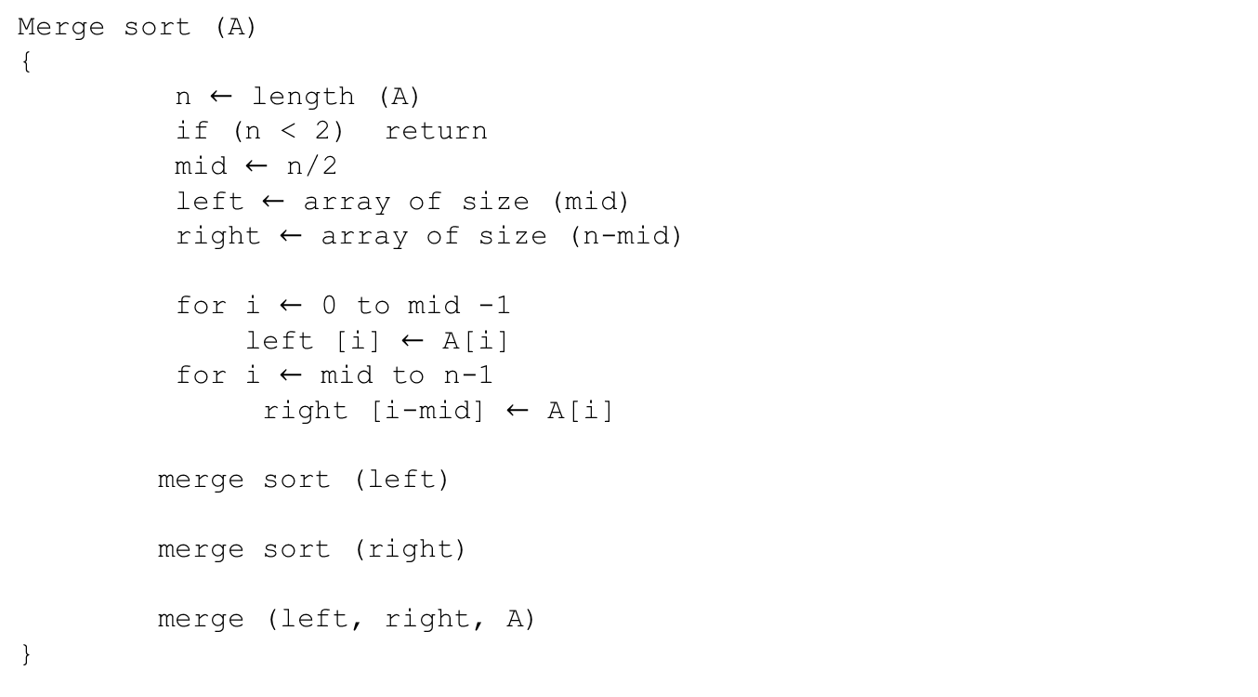
Pseudocode of merge sort

Slide 26
98
23
45
14
6
67
33
42
98
23
45
14
6
67
33
42
98
23
45
14
98
23
45
45
14
14
23
23
98
14
Merge
Merge
Merge

Slide 27
98
23
45
14
6
67
33
42
98
23
45
14
6
67
33
42
98
23
45
14
98
23
45
14
23
98
14
45
Merge

Slide 28
98
23
45
14
6
67
33
42
98
23
45
14
6
67
33
42
98
23
45
14
98
23
45
14
23
98
14
45
Merge

Slide 29
98
23
45
14
6
67
33
42
98
23
45
14
6
67
33
42
98
23
45
14
98
23
45
14
23
98
14
45
14
Merge

Slide 30
98
23
45
14
6
67
33
42
98
23
45
14
6
67
33
42
98
23
45
14
98
23
45
14
23
98
14
45
14
23
Merge

Slide 31
98
23
45
14
6
67
33
42
98
23
45
14
6
67
33
42
98
23
45
14
98
23
45
14
23
98
14
45
14
23
45
Merge

Slide 32
98
23
45
14
6
67
33
42
98
23
45
14
6
67
33
42
98
23
45
14
98
23
45
14
23
98
14
45
14
23
45
98
Merge

Slide 33
98
23
45
14
6
67
33
42
98
23
45
14
6
67
33
42
98
23
45
14
6
67
33
42
98
23
45
14
23
98
14
45
14
23
45
98

Slide 34
98
23
45
14
6
67
33
42
98
23
45
14
6
67
33
42
98
23
45
14
6
67
33
42
98
23
45
14
6
67
23
98
14
45
14
23
45
98

Slide 35
98
23
45
14
6
67
33
42
98
23
45
14
6
67
33
42
98
23
45
14
6
67
33
42
98
23
45
14
6
67
23
98
14
45
14
23
45
98
Merge

Slide 36
98
23
45
14
6
67
33
42
98
23
45
14
6
67
33
42
98
23
45
14
6
67
33
42
98
23
45
14
6
67
23
98
14
45
6
14
23
45
98
Merge

Slide 37
98
23
45
14
6
67
33
42
98
23
45
14
6
67
33
42
98
23
45
14
6
67
33
42
98
23
45
14
6
67
23
98
14
45
6
67
14
23
45
98
Merge

Slide 38
98
23
45
14
6
67
33
42
98
23
45
14
6
67
33
42
98
23
45
14
6
67
33
42
98
23
45
14
6
67
33
42
23
98
14
45
6
67
14
23
45
98

Slide 39
98
23
45
14
6
67
33
42
98
23
45
14
6
67
33
42
98
23
45
14
6
67
33
42
98
23
45
14
6
67
33
42
23
98
14
45
6
67
14
23
45
98
Merge

Slide 40
98
23
45
14
6
67
33
42
98
23
45
14
6
67
33
42
98
23
45
14
6
67
33
42
98
23
45
14
6
67
33
42
23
98
14
45
6
67
33
14
23
45
98
Merge

Slide 41
98
23
45
14
6
67
33
42
98
23
45
14
6
67
33
42
98
23
45
14
6
67
33
42
98
23
45
14
6
67
33
42
23
98
14
45
6
67
33
42
14
23
45
98
Merge

Slide 42
98
23
45
14
6
67
33
42
98
23
45
14
6
67
33
42
98
23
45
14
6
67
33
42
98
23
45
14
6
67
33
42
23
98
14
45
6
67
33
42
14
23
45
98
Merge

Slide 43
98
23
45
14
6
67
33
42
98
23
45
14
6
67
33
42
98
23
45
14
6
67
33
42
98
23
45
14
6
67
33
42
23
98
14
45
6
67
33
42
14
23
45
98
6
Merge

Slide 44
98
23
45
14
6
67
33
42
98
23
45
14
6
67
33
42
98
23
45
14
6
67
33
42
98
23
45
14
6
67
33
42
23
98
14
45
6
67
33
42
14
23
45
98
6
33
Merge

Slide 45
98
23
45
14
6
67
33
42
98
23
45
14
6
67
33
42
98
23
45
14
6
67
33
42
98
23
45
14
6
67
33
42
23
98
14
45
6
67
33
42
14
23
45
98
6
33
42
Merge

Slide 46
98
23
45
14
6
67
33
42
98
23
45
14
6
67
33
42
98
23
45
14
6
67
33
42
98
23
45
14
6
67
33
42
23
98
14
45
6
67
33
42
14
23
45
98
6
33
42
67
Merge

Slide 47
98
23
45
14
6
67
33
42
98
23
45
14
6
67
33
42
98
23
45
14
6
67
33
42
98
23
45
14
6
67
33
42
23
98
14
45
6
67
33
42
14
23
45
98
6
33
42
67
Merge

Slide 48
98
23
45
14
6
67
33
42
98
23
45
14
6
67
33
42
98
23
45
14
6
67
33
42
98
23
45
14
6
67
33
42
23
98
14
45
6
67
33
42
14
23
45
98
6
33
42
67
6
Merge

Slide 49
98
23
45
14
6
67
33
42
98
23
45
14
6
67
33
42
98
23
45
14
6
67
33
42
98
23
45
14
6
67
33
42
23
98
14
45
6
67
33
42
14
23
45
98
6
33
42
67
6
14
Merge

Slide 50
98
23
45
14
6
67
33
42
98
23
45
14
6
67
33
42
98
23
45
14
6
67
33
42
98
23
45
14
6
67
33
42
23
98
14
45
6
67
33
42
14
23
45
98
6
33
42
67
6
14
23
Merge

Slide 51
98
23
45
14
6
67
33
42
98
23
45
14
6
67
33
42
98
23
45
14
6
67
33
42
98
23
45
14
6
67
33
42
23
98
14
45
6
67
33
42
14
23
45
98
6
33
42
67
6
14
23
33
Merge

Slide 52
98
23
45
14
6
67
33
42
98
23
45
14
6
67
33
42
98
23
45
14
6
67
33
42
98
23
45
14
6
67
33
42
23
98
14
45
6
67
33
42
14
23
45
98
6
33
42
67
6
14
23
33
42
Merge

Slide 53
98
23
45
14
6
67
33
42
98
23
45
14
6
67
33
42
98
23
45
14
6
67
33
42
98
23
45
14
6
67
33
42
23
98
14
45
6
67
33
42
14
23
45
98
6
33
42
67
6
14
23
33
42
45
Merge

Slide 54
98
23
45
14
6
67
33
42
98
23
45
14
6
67
33
42
98
23
45
14
6
67
33
42
98
23
45
14
6
67
33
42
23
98
14
45
6
67
33
42
14
23
45
98
6
33
42
67
6
14
23
33
42
45
67
Merge

Slide 55
98
23
45
14
6
67
33
42
98
23
45
14
6
67
33
42
98
23
45
14
6
67
33
42
98
23
45
14
6
67
33
42
23
98
14
45
6
67
33
42
14
23
45
98
6
33
42
67
6
14
23
33
42
45
67
98
Merge

Slide 56
98
23
45
14
6
67
33
42
98
23
45
14
6
67
33
42
98
23
45
14
6
67
33
42
98
23
45
14
6
67
33
42
23
98
14
45
6
67
33
42
14
23
45
98
6
33
42
67
6
14
23
33
42
45
67
98

Slide 57
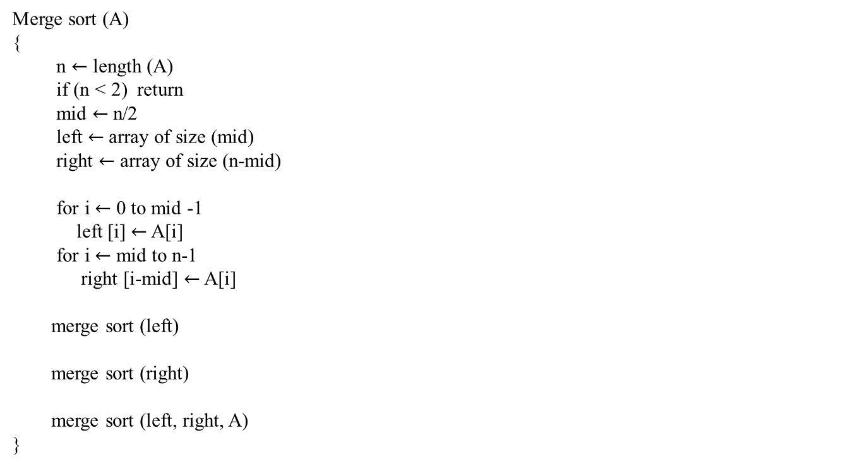
Time complexity
C, if n=1
T(n)
C1
2T(n/2) + C’n, if n>1
C2.n
T(n/2)
T(n/2)
C3.n+C4

Slide 58
Time complexity(cont..,)
T(n) = 2T(n/2)+c`n
= 2{2T(n/4) +c` n/2} + c`n
= 4T(n/4) +2c`n
= 4{2T(n/8)+c`.n/4}+2c`n
= 8T (n/8)+3c`n
= 16T(n/16) +4c`n
= 2^{K} T (n/2^{K}) + K c`n ---------------------------------------------1
n/2^{K} = 1 2^{K} = n
K = log₂n
Substituent k value in equation 1 and you will get the following equation
nc+c`nlogn O(nlogn)

Slide 59
Assume n = 2^{k}
98
23
45
14
6
67
33
42
Number of operations = (2¹ + 2² + … + 2^{k} ) O(1) = 2 (2^{k+1} – 1) O(1)
= (4 2^{k} – 2) O(1) = (4n -2) O(1) = O(n)
2¹ O(1)
98
23
45
14
6
67
33
42
log n
2² O(1)
98
23
45
14
6
67
33
42
2³ O(1)
98
23
45
14
6
67
33
42
23
98
14
45
6
67
33
42
O(n)
Number of operations = (log n) (O(n)) = O(n logn)
log n
14
23
45
98
6
33
42
67
O(n)
6
14
23
33
42
45
67
98
O(n)

Slide 60
98
23
45
14
6
67
33
42
6
14
23
33
42
45
67
98

Slide 61
Merge Sort Strategy
Divide stage: Split the n-element sequence into two subsequences of n/2 elements each
Conquer stage: Recursively sort the two subsequences
Combine stage: Merge the two sorted subsequences into one sorted sequence (the solution)
n (unsorted)
n/2 (unsorted)
n/2 (unsorted)
MERGE SORT
MERGE SORT
n/2 (sorted)
n/2 (sorted)
MERGE
n (sorted)

Slide 62
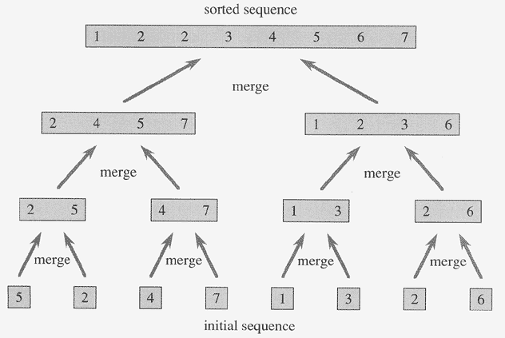
Copyright © The McGraw-Hill Companies, Inc. Permission required for reproduction or display.
Merging Sorted Sequences

Slide 63
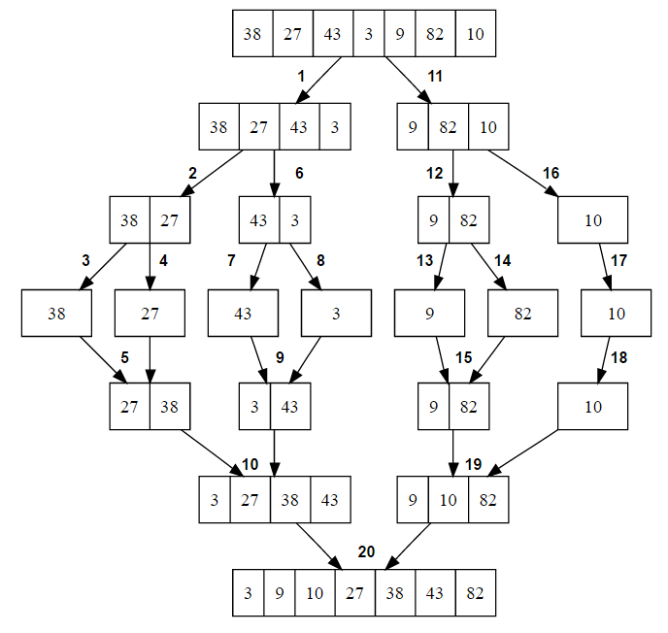

Slide 64
Thank You!!

